Slide 1
Operating System Lab
Lect-2

Slide 2
Low Level Function Calls
Input and output uses the read and the write system calls, which are accessed from C program through functions read and write.
For both, the first argument is a file descriptor.
The second argument is a character array where the data is to go or come from.
The third argument is the number of bytes to be transferred.

Slide 3
Low Level Function Calls
Syntax: int n_read = read(int fd, char* buf, int n); int n_written = write(int fd, char* buf, int n);

Slide 4
Low Level Function Calls
Any number of bytes can be read or written in one call.
The most common value is 1, which means one character at a time (unbuffered), and a number like 1024 or 4096 that corresponds to a physical block size on a peripheral device.

Slide 5
Example: Create a File and Write Data
#include<stdio.h> … int main(){ char buf[] = "Sentence to be written in file"; int handle = 0, len = strlen(buf); handle = creat(“A.Txt", O_WRONLY | _S_IREAD | _S_IWRITE);
if( -1 == handle)
{ printf("Error Creating File\n"); exit(-1); }
if(len == write(handle, buf, len)) /* write Date to the file */
{ printf("Wrote %d Byte\n", len); }
else
{ printf("Unsuccessful in writing\n"); }
close(handle); /* close the file */ return 0;}
Notes:
C_Slide_Samples\Write.c

Slide 6
The open Function
If we want to write data to a file, we need to open the file in write mode, if the file exists or create a new file. This can be done with the open function.
Once we have finished writing to the file, the file is closed using the close function.
The syntax for the open function is: int open(char* name, int flags, int perms);
The first argument is the name of the file.

Slide 7
The open Function
The second argument is an int that specifies how the file is to be opened, the values are:
O_RDONLY open for reading only
O_WRONLY open for writing only.
O_RDWR open for both reading and writing
These constants are defined in fcntl.h
The third parameter specifies the permission of the file.
Notes:
C_Slide_Samples\Open.c

Slide 8
Read/Write File
For reading and writing , use the read and write function
read/write takes 3 arguments
From where to read or write
A buffer variable for data
How many bytes to write
Each call returns a count of number of bytes transferred.
On reading , the number of bytes may be less than the number requested. A return value of 0 bytes implies end of file, and –1 indicates an error of some sort
On writing, the return value is the number of bytes written; an error has occurred if this isn’t equal to the number requested

Slide 9
Example (read)
#include <stdio.h>
int main() { char buf[10]; int fd = 0, len = 1, res = 0; fd = open("A.Txt", O_RDONLY, 0 ); if( -1 == handle) { printf("Error Creating File\n"); exit(-1); } while(res = read(fd, buf, len)!= 0) { buf[res] = '\0'; printf("%s", buf); } close(fd); /* close the file */ return 0; }
Notes:
C_Slide_Samples\Read.c

Slide 10
Interprocess Communication (pipes)
Pipe is the most traditional Unix inter-process communication
The pipe function creates a communication buffer that the caller can access through the file descriptors.
The data written to one file descriptor and read from the other on a first-in-first-out basis.

Slide 11
Pipes are typically used to communicate between two different processes:
Process A (parent) creates a pipe
Process A forks twice, creating B and C.
Each process closes the ends of the pipe it does not need.
Process B closes downstream end
Process C closes upstream end
Process A closes both ends
Processes B and C execute other programs, using exec, where file descriptors are retained.

Slide 12
Synchronization Using Pipes
Have finite capacity (few hundred bytes)
This imposes loose synchronization between up and down stream processes:
Upstream process blocks if pipe is full
Until downstream consumes some
Downstream process blocks if pipe is empty
Until upstream writes some
If upstream closes descriptor, a downstream read operation will return EOF (0)

Slide 13
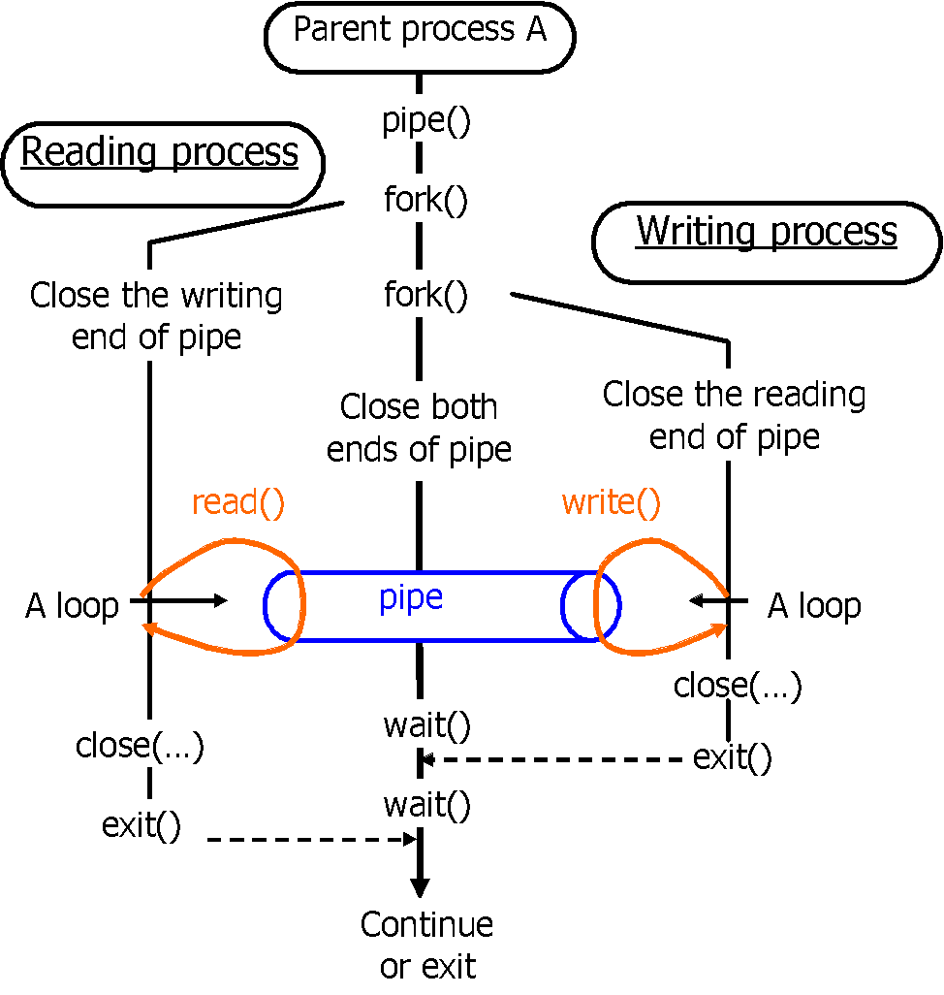
Using Pipes

Slide 14
Closing upstream end of pipe is essential for 1st process otherwise it will never see EOF
A pair of wait() are there to ensure that parent will not return before both children have finished

Slide 15
How to Create Pipes
#include <stdio.h>
#include <string.h>
#include <unistd.h>
#include <sys/types.h>
int fd[2];
if (pipe(fd) == -1)
perror("Failed to create the pipe");

Slide 16
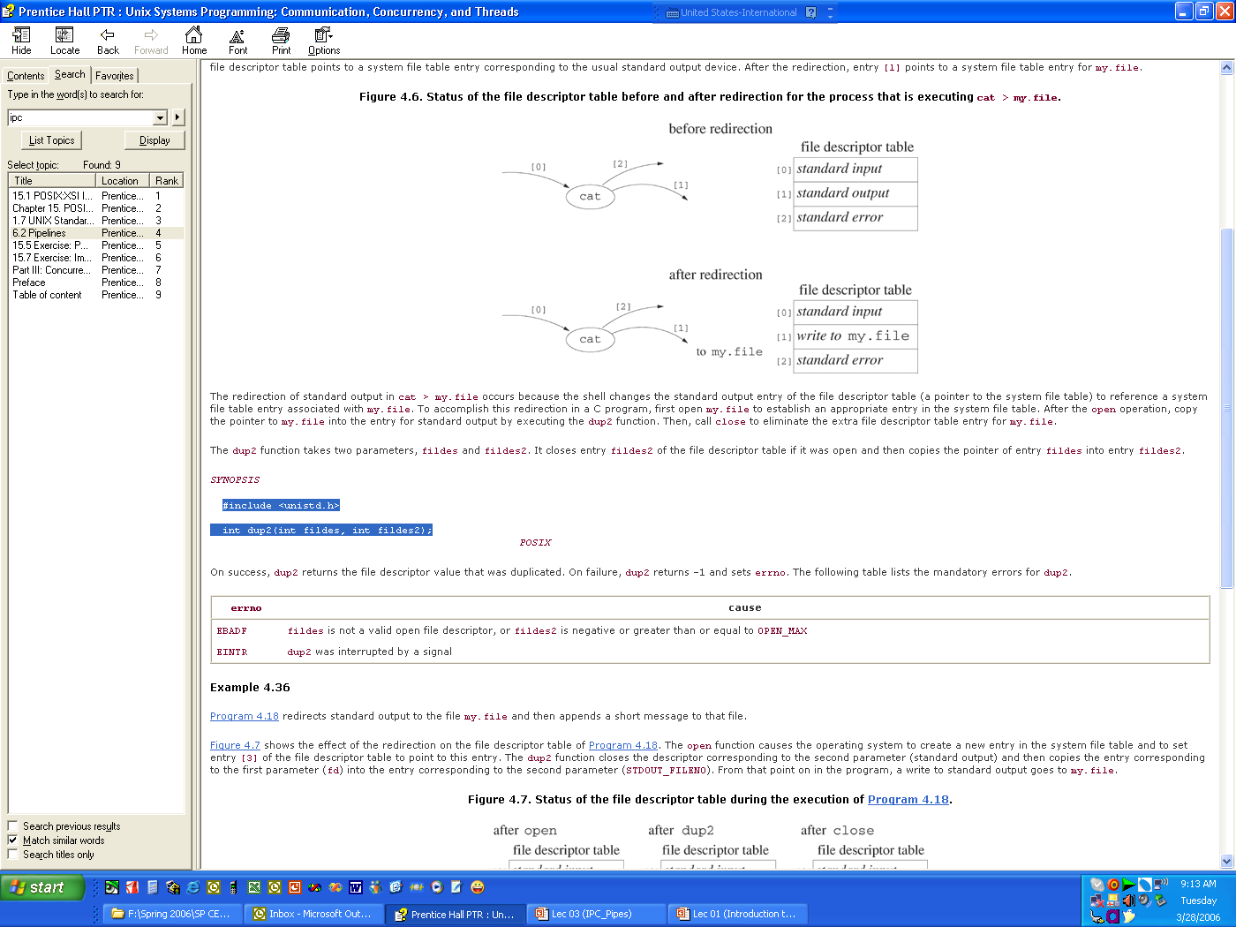
Redirection
#include <unistd.h>
int dup2(int OldFileDes, int NewFileDes);
takes an existing file descriptor (OldFileDes) and duplicates it into (NewFileDes)
Example:
fd = open("my.file“,O_RDRW )
dup2(fd,1)

Slide 17
Example
who | sort
The shell gets the output of who connected to the upstream end of the pipe, and the input to sort connected to the downstream end.
Shell uses dup2 to do the plumbing:
dup2(old, new):
takes an existing file descriptor (old) and duplicates it into (new).
int p[2];
pipe(p);
dup2(p[1], 1);
/*standard output connected upstream end of pipe*/

Slide 18
Example
main() {
int fds[2];
pipe(fds);
/*child 1 duplicates downstream into stdin */
if (fork() == 0) {
dup2(fds[0], 0);
close(fds[1]);
execlp(“sort”, “sort”, 0); }
/*child 2 duplicates upstream into stdout */
else if fork() == 0) {
dup2(fds[1], 1);
close(fds[0]);
execlp(“who”, ”who”, 0); }
else{ /*parent closes both ends and wait for children*/
close(fds[0]);
close(fds[1]);
wait(0);
wait(0); }
}

Slide 19
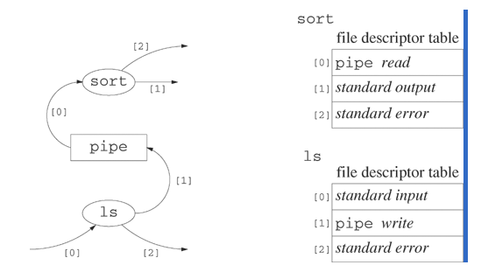
Example

Slide 20
Pipes Characteristics
Unidirectional
Pipes can only be used between processes that have a common ancestor (named pipes)
No mechanism to authenticate
Do not work across the network
They are the easiest of IPC mechanisms. Simple, easy to understand and easy to implement as well.

